Slide 1
Chapter 6
Bandwidth Utilization: Multiplexing and Spreading
6.1
Notes:
*

Slide 2
Bandwidth Utilization
Bandwidth utilization is the wise use of available bandwidth to achieve specific goals. In this chapter, we explore these two broad categories of bandwidth utilization: multiplexing and spreading.
Efficiency can be achieved by multiplexing by combining several channels into one.
In spreading, our goals are privacy and antijamming; we expand the bandwidth of a channel to insert redundancy, which is necessary to achieve these goals.
6.2
Notes:
*

Slide 3
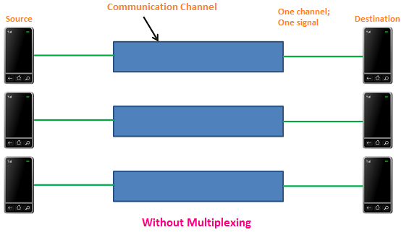
Without Multiplexing
The communication system without multiplexing carries only one signal at any moment in time.
Thus, it uses three communication channels to carry three signals. In this technique, a large amount of bandwidth is wasted.
6.3
Notes:
*

Slide 4
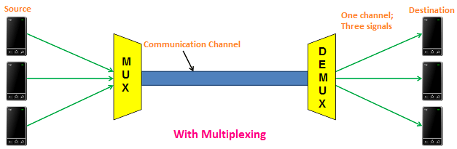
With Multiplexing
It carries three signals simultaneously. Thus, it uses only one communication channel to carry 3 signals (multiple signals). In this technique, the bandwidth is effectively used.
6.4
Notes:
*

Slide 5
Multiplexing
Whenever the bandwidth of a medium linking two devices is greater than the bandwidth needs of the devices, the link can be shared.
Multiplexing is the set of techniques that allows the simultaneous transmission of multiple signals across a single data link.
If the bandwidth of a link is greater than the bandwidth needs of the devices connected to it, the bandwidth is wasted.
6.5
Notes:
*

Slide 6
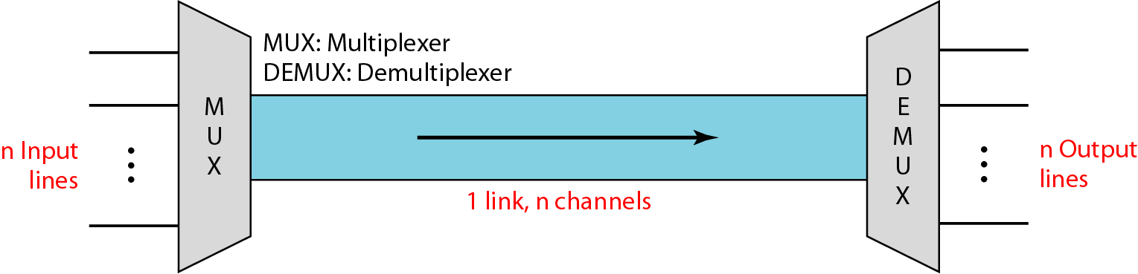
Multiplexing
In a multiplexed system, n lines share the bandwidth of one link.
The lines on the left direct their transmission streams to a multiplexer (MUX), which combines them into a single stream (many to one).
At the receiving end, that stream is fed into a demultiplexer (DEMUX), which separates the stream back into its component transmissions (one-to-many) and directs them to their corresponding lines.
In the figure, the word link refers to the physical path. The word channel refers to the portion of a link that carries a transmission between a given pair of lines. One link can have many (n) channels.
6.6
Notes:
*

Slide 7
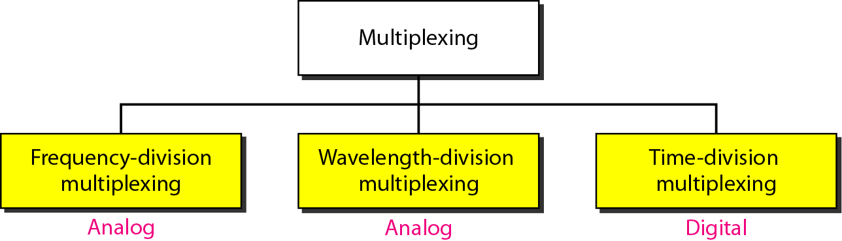
Categories of Multiplexing
Analog Multiplexing: The process of combining multiple analog signals into one signal is called analog multiplexing. It multiplexes the analog signals according to their frequency or wavelength.
Digital Multiplexing: The process of combining multiple digital signals into one signal is called digital multiplexing.
6.7
Notes:
*

Slide 8
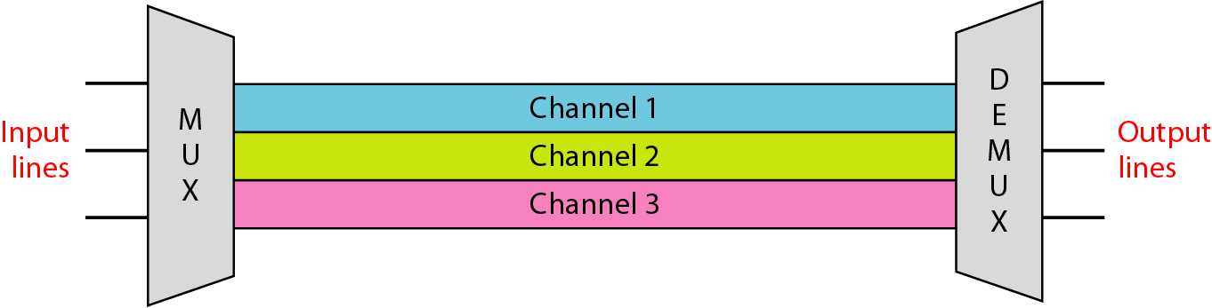
Frequency-division multiplexing (FDM)
FDM is an analog multiplexing technique that combines analog signals.
Frequency-division multiplexing (FDM) is an analog technique that can be applied when the bandwidth of a link (in hertz) is greater than the combined bandwidths of the signals to be transmitted.
In FDM, signals generated by each sending device are modulated using different carrier frequencies.
These modulated signals are then combined into a single composite signal that can be transported by the link.
Channels can be separated from strips of unused bandwidths called guard bands to prevent signals from overlapping.
6.8
Notes:
*

Slide 9
Frequency-division multiplexing (FDM)
The frequency division multiplexing divides the bandwidth of a channel into several logical sub-channels. Each logical sub-channel is allotted for a different signal frequency. The individual signals are filtered and then modulated (frequency is shifted), in order to fit exactly into logical sub-channels.
In this technique, each logical sub-channel (individual signal frequency) is allotted to each user. In other words, each user owns a sub-channel.
Each logical sub-channel is separated by an unused bandwidth called Guard Band to prevent overlapping of signals. In other words, there exists a frequency gap between two adjacent signals to prevent signal overlapping. A guard band is a narrow frequency range that separates two signal frequencies.
6.9
Notes:
*

Slide 10
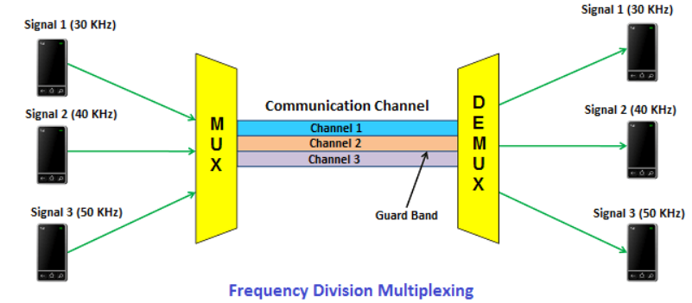
How Frequency-division multiplexing (FDM) actually works?
The transmitter end contains multiple transmitters and the receiver end contains multiple receivers. The communication channel is present between the transmitter and receiver.
At transmitter end, each transmitter sends a signal of different frequency. In the below figure, the transmitter 1 sends a signal of 30 kHz, transmitter 2 sends a signal of 40 kHz, and transmitter 3 sends a signal of 50 kHz. These signals of different frequencies are then multiplexed or combined by using a device called multiplexer. It then transmits the multiplexed signals over a communication channel.
6.10
Notes:
*

Slide 11
How Frequency-division multiplexing (FDM) actually works?
At the receiver end, the multiplexed signals are separated by using a device called demultiplexer. It then sends the separated signals to the respective receivers. In the above figure, the receiver 1 receives signal of 30 kHz, receiver 2 receives signal of 40 kHz, and receiver 3 receives signal of 50 kHz.
6.11
Notes:
*

Slide 12
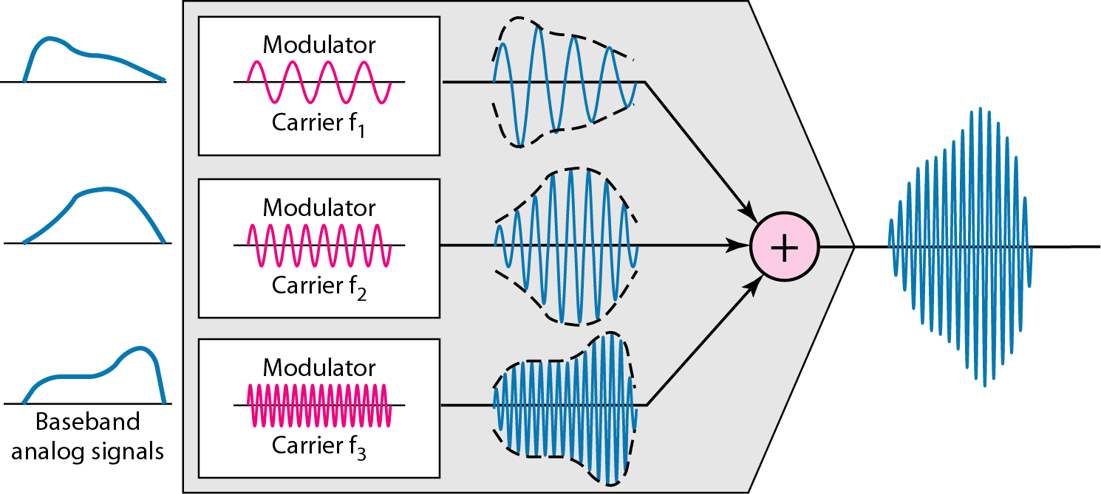
FDM: Multiplexing process
Each source generates a signal of a similar frequency range.
Inside the multiplexer, these similar signals modulates different carrier frequencies (f1, f2, and f3).
The resulting modulated signals are then combined into a single composite signal that is sent out over a media link that has enough bandwidth to accommodate it.
6.12
Notes:
*

Slide 13
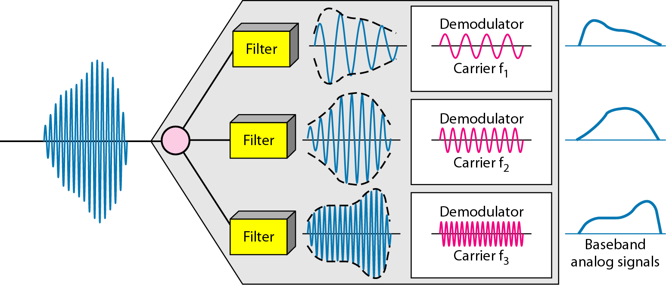
FDM: Demultiplexing process
The demultiplexer uses a series of filters to decompose the multiplexed signal into its constituent component signals.
The individual signals are then passed to a demodulator that separates them from their carriers and passes them to the output lines.
6.13
Notes:
*

Slide 14
Example - 6.1
Assume that a voice channel occupies a bandwidth of 4 kHz. We need to combine three voice channels into a link with a bandwidth of 12 kHz, from 20 to 32 kHz. Show the configuration, using the frequency domain. Assume there are no guard bands.
Solution: We shift (modulate) each of the three voice channels to a different bandwidth, as shown in Figure 6.6. We use the 20 to 24 kHz bandwidth for the first channel, the 24 to 28 kHz bandwidth for the second channel, and the 28 to 32 kHz bandwidth for the third one. Then we combine them as shown in Figure 6.6.
6.14
Notes:
*

Slide 15
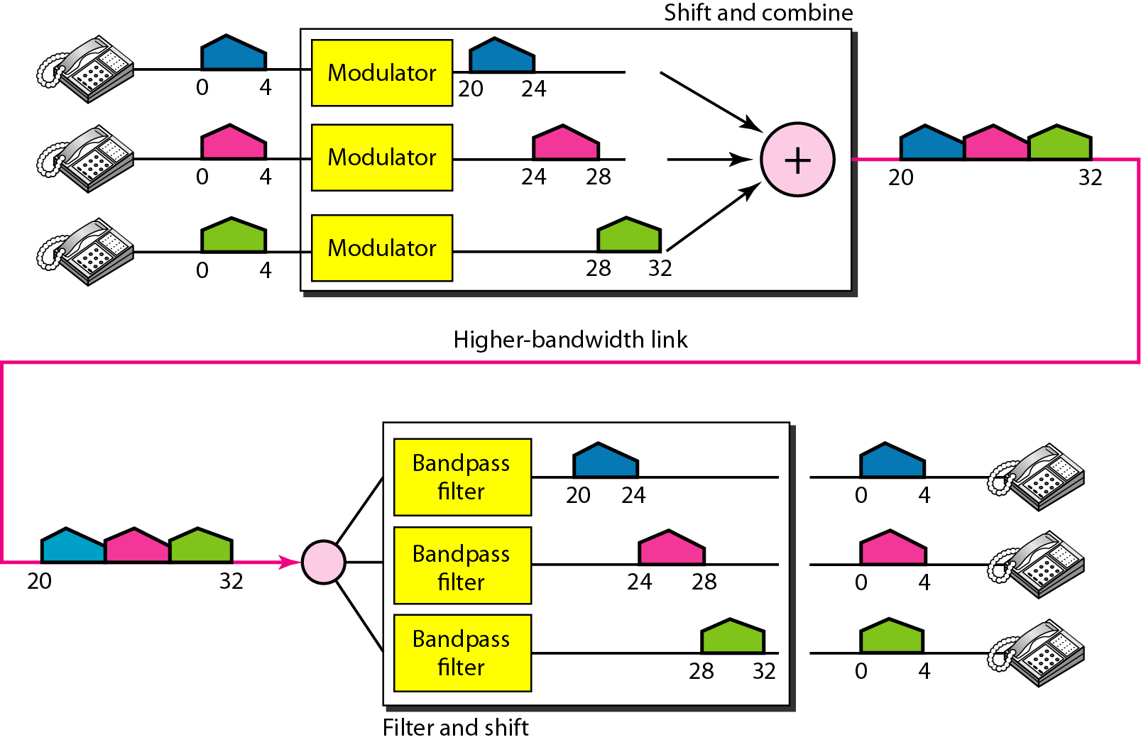
Figure 6.6 Solution for Example 6.1
6.15
Notes:
*

Slide 16
Example 6.2
Five channels, each with a 100-kHz bandwidth, are to be multiplexed together. What is the minimum bandwidth of the link if there is a need for a guard band of 10 kHz between the channels to prevent interference?
Solution: For five channels, we need at least four guard bands. This means that the required bandwidth is at least
5 × 100 + 4 × 10 = 540 kHz,
as shown in Figure 6.7.
6.16
Notes:
*

Slide 17
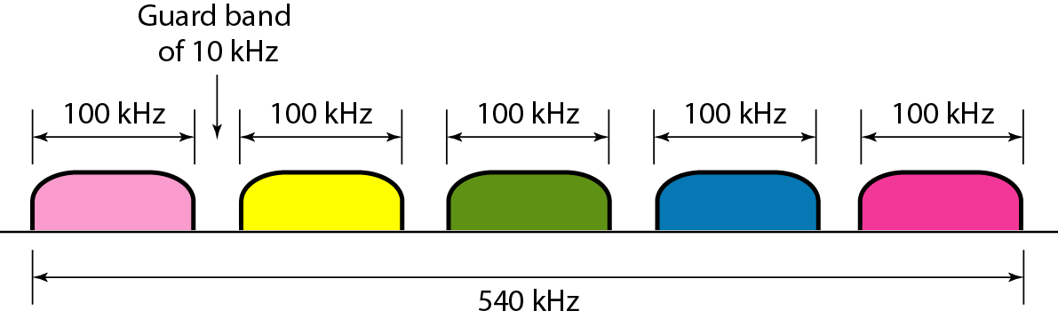
Figure 6.7 Example 6.2
6.17
Notes:
*

Slide 18
Applications of Frequency Division Multiplexing
AM radio broadcasting
FM radio broadcasting
Television broadcasting
First generation cellular phone also uses FDM
6.18
Notes:
*

Slide 19
Advantages and disadvantages of Frequency Division Multiplexing
Advantages
It does not need Synchronization between transmitter and receiver.
It transmits multiple signals simultaneously.
In frequency division multiplexing, the demodulation process is easy.
Disadvantages
It needs a large bandwidth communication channel.
6.19
Notes:
*

Slide 20
Wavelength-division multiplexing (WDM)
WDM is conceptually the same as FDM, except that the multiplexing and demultiplexing involve optical signals transmitted through fiber-optic channels.
The idea is the same: We are combining different signals of different frequencies. The difference is that the frequencies are very high.
The only difference is in wavelength division multiplexing optical signals are used instead of electrical signals. In wavelength division multiplexing, optical signals are transmitted through fiber optic cables.
6.20
Notes:
*

Slide 21
Wavelength-division multiplexing (WDM)
Why wavelength division multiplexing?
Wavelength-division multiplexing (WDM) is designed to use the high-data-rate capability of fiber-optic cable.
The optical fiber data rate is higher than the data rate of metallic transmission cable.
Using a fiber-optic cable for one single line wastes the available bandwidth. Multiplexing allows us to combine several lines into one.
6.21
Notes:
*

Slide 22
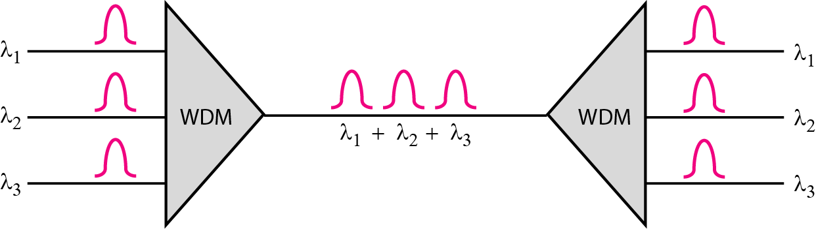
Wavelength-division multiplexing (WDM)
Wavelength division multiplexing is a technology in which multiple optical signals (laser light) of different wavelengths or colors are combined into one signal and is transmitted over the communication channel. Thus multiple signals are transmitted simultaneously over a single communication channel.
Very narrow bands of light from different sources are combined to make a wider band of light.
6.22
Notes:
*

Slide 23
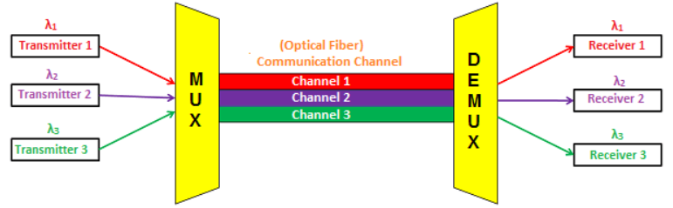
How Wavelength-division multiplexing (WDM) actually works?
In this technique, the bandwidth of the communication channel should be greater than the combined bandwidth of individual signals.
The wavelength division multiplexing divides the bandwidth of a channel into several logical sub-channels according to its wavelength. It allots each logical sub-channel for a different light color or optical signal wavelength. The individual signals are filtered and then modulated (wavelength is shifted), to fit exactly into logical sub-channels.
In this technique, each logical sub-channel (individual signal wavelength) is allotted to each user. In other words, each user owns a sub-channel.
6.23
Notes:
*

Slide 24
How Wavelength-division multiplexing (WDM) actually works?
The multiplexed signals are then transmitted over a single communication channel (optical fiber). In between the transmitter and receiver, optical amplifiers are used to compensate the optical signal loss caused during the transmission.
At the receiver end, the multiplexed signals are separated by using a device called demultiplexer. The separated signals are then sent to the respective receivers.
6.24
Notes:
*

Slide 25
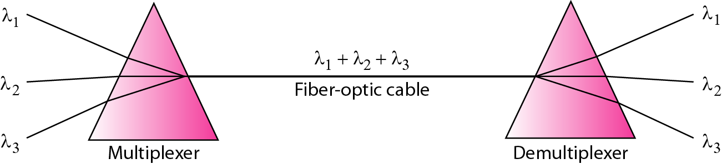
Prisms in wavelength-division multiplexing and demultiplexing
We want to combine multiple light sources into one single light at the multiplexer and do the reverse at the demultiplexer. The combining and splitting of light sources are easily handled by a prism.
Recall from basic physics that a prism bends a beam of light based on the angle of incidence and the frequency. Using this technique, a multiplexer can be made to combine several input beams of light, each containing a narrow band of frequencies, into one output beam of a wider band of frequencies.
6.25
Notes:
*

Slide 26
Advantages of WDM
It allows transmission of data in two directions simultaneously
Low cost
Greater transmission capacity
High security
Long distance communication with low signal loss
6.26
Notes:
*

Slide 27
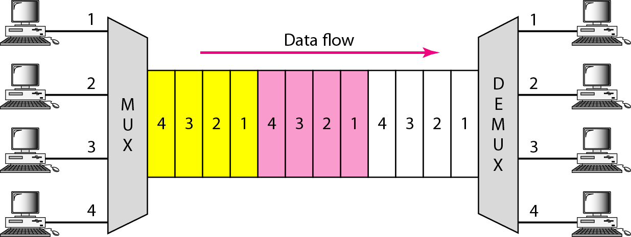
Time Division Multiplexing (TDM)
Time-division multiplexing (TDM) is a digital process that allows several connections to share the high bandwidth of a line.
Instead of sharing a portion of the bandwidth as in FDM, time is shared.
TDM is a digital multiplexing technique for combining several low-rate channels into one high-rate one.
6.27
Notes:
*

Slide 28
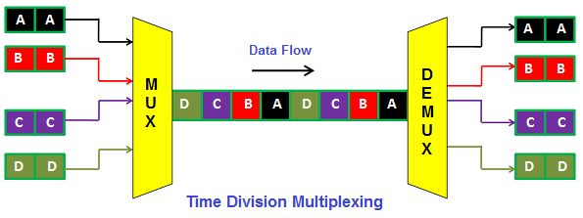
Time Division Multiplexing (TDM)
In frequency division multiplexing, the sharing of a channel is done on the basis of frequency. But in time division multiplexing, the sharing of a channel is done on the basis of time.
In time division multiplexing, each user is allotted a particular time interval called time slot during which data is transmitted. The time interval (time slot) allotted to each receiver (user) is so small that the receiver will not detect that some time was used to serve another receiver (user).
6.28
Notes:
*

Slide 29
Time Division Multiplexing (TDM)
In time division multiplexing, all signals are not transmitted simultaneously; instead, they are transmitted one after another. For example, as shown in the above figure, at first, we send signal A. Then after second signal B and then after third signal C and finally, we send last signal D. Thus, each user occupies an entire bandwidth for a short period of time.
6.29
Notes:
*

Slide 30
Types of Time Division Multiplexing (TDM)
Synchronous Time division multiplexing
Asynchronous Time division multiplexing (Statistical Time Division Multiplexing)
6.30
Notes:
*

Slide 31
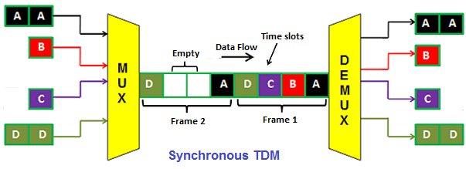
How Synchronous time-division multiplexing actually works?
In synchronous time division multiplexing, each device (transmitter) is allotted with a fixed time slot, regardless of the fact that the device (transmitter) has any data to transmit or not.
The device has to transmit data within this time slot. If the device (transmitter) does not have any data to send then its time slot remains empty.
As shown in the below figure, the various time slots are arranged into frames and each frame consists of one or more time slots dedicated to each device (transmitter). For example, if there are 3 devices, there will be 3 slots in each frame. Similarly, if there are 5 devices, there will be 5 slots in each frame.
6.31
Notes:
*

Slide 32
How Synchronous time-division multiplexing actually works?
The above figure shows 4 devices (transmitter A, transmitter B, transmitter C, and transmitter D) that have 4 dedicated time slots (time slot A, time slot B, time slot C and time slot D).
The transmitter A data is sent at time slot A, transmitter B data is sent at time slot B, transmitter C data is sent at time slot C and transmitter D data is sent at time slot D.
In the time frame 2, the transmitter B and C does not have any data to send so the time slot B and C remains empty.
The main drawback of synchronous time division multiplexing is that the channel capacity is not fully utilized. Hence, the bandwidth goes wasted.
6.32
Notes:
*

Slide 33
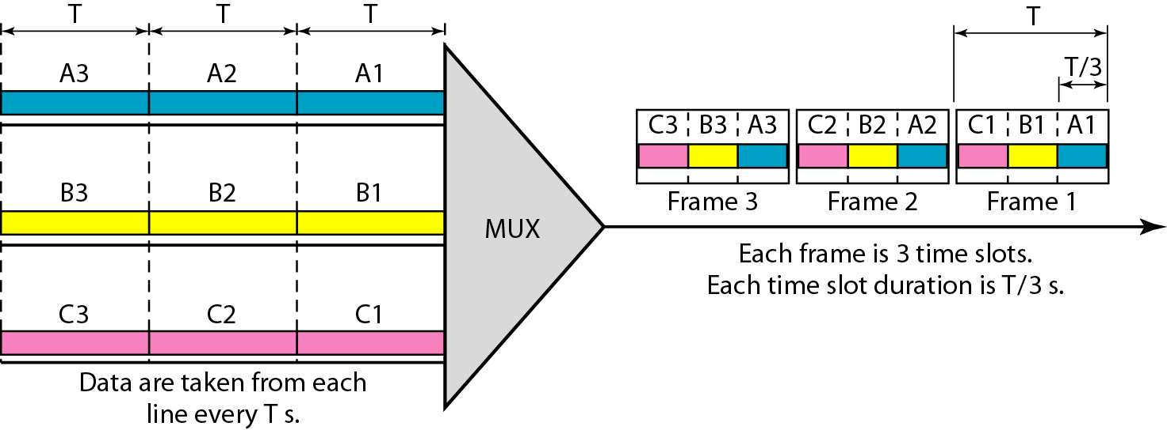
How Synchronous time-division multiplexing actually works?
In synchronous TDM, the data flow of each input connection is divided into units, where each input occupies one input time slot.
A unit can be 1 bit, one character, or one block of data.
Each input unit becomes one output unit and occupies one output time slot.
The duration of an output time slot is n times shorter than the duration of an input time slot.
If an input time slot is T sec, the output time slot is T/n sec, where n is the number of connections.
6.33
Notes:
*

Slide 34
How Synchronous time-division multiplexing actually works?
In synchronous TDM, a round of data units from each input connection is collected into a frame.
If we have n connections, a frame is divided into n time slots and one slot is allocated for each unit, one for each input line.
If the duration of the input unit is T, the duration of each slot is T/n and the duration of each frame is T.
6.34
Notes:
*

Slide 35
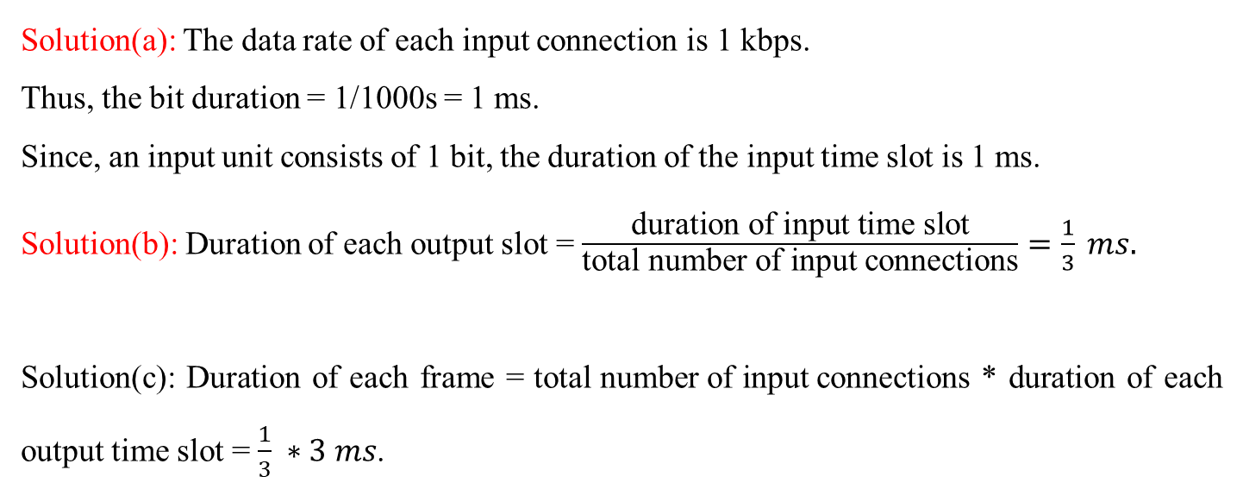
Example 6.5
The data rate for each one of the 3 input connection is 1 kbps. If 1 bit at a time is multiplexed (a unit is 1 bit), what is the duration of (a) each input slot, (b) each output slot, and (c) each frame?
6.35
Notes:
*

Slide 36
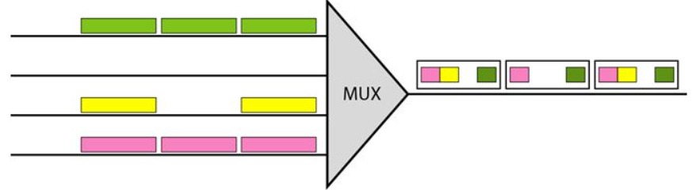
Empty slots in Synchronous TDM
If a source does not have data to send, the corresponding slot in the output frame is empty.
The first output frame has three slots filled, the second frame has two slots filled, and the third frame has three slots filled.
6.36
Notes:
*

Slide 37
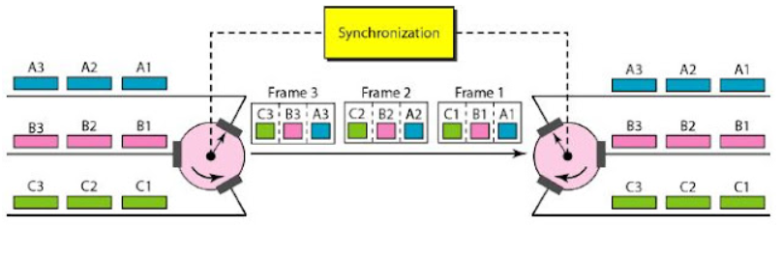
Interleaving in Synchronous TDM
TDM can be visualized as two fast-rotating switches, one on the multiplexing side and the other on the demultiplexing side.
The switches are synchronized and rotate at the same speed, but in opposite directions. On the multiplexing side, as the switch opens in front of a connection, that connection has the opportunity to send a unit onto the path. This process is called interleaving. On the demultiplexing side, as the switch opens in front of a connection, that connection has the opportunity to receive a unit from the path.
6.37
Notes:
*

Slide 38
Data rate management in Synchronous TDM
One problem with TDM is how to handle a disparity in the input data rates. If data rates are not the same, three strategies, or a combination of them, can be used. The three different strategies are multilevel multiplexing, multiple-slot allocation, and pulse stuffing.
6.38
Notes:
*

Slide 39
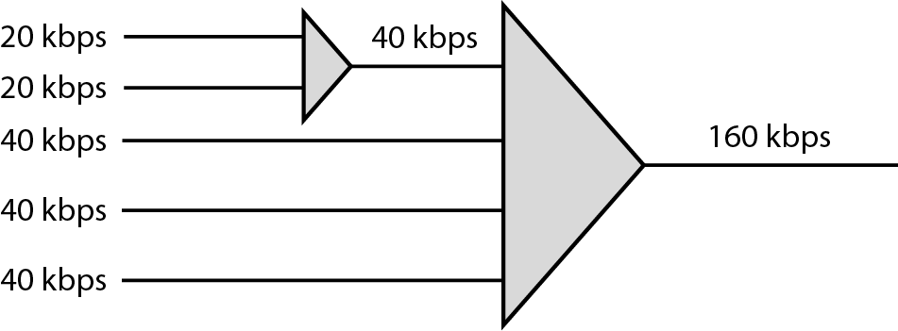
Multilevel multiplexing
Multilevel multiplexing is a technique used when the data rate of an input line is a multiple of others. For example, if we have two inputs of 20 kbps and three inputs of 40 kbps. The first two input lines can be multiplexed together to provide a data rate equal to the last three. A second level of multiplexing can create an output of 160 kbps.
6.39
Notes:
*

Slide 40
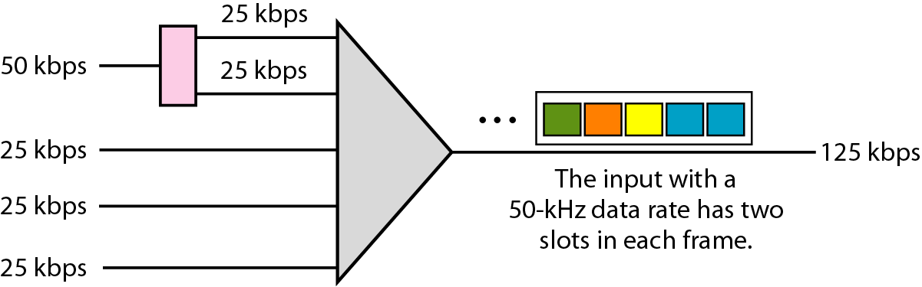
Multiple-slot multiplexing
Sometimes it is more efficient to allot more than one slot in a frame to a single input line. For example, we might have an input line that has a data rate that is a multiple of another input. The input line with a 50-kbps data rate can be given two slots in the output. We insert a serial-to-parallel converter in the line to make two inputs out of one.
6.40
Notes:
*

Slide 41
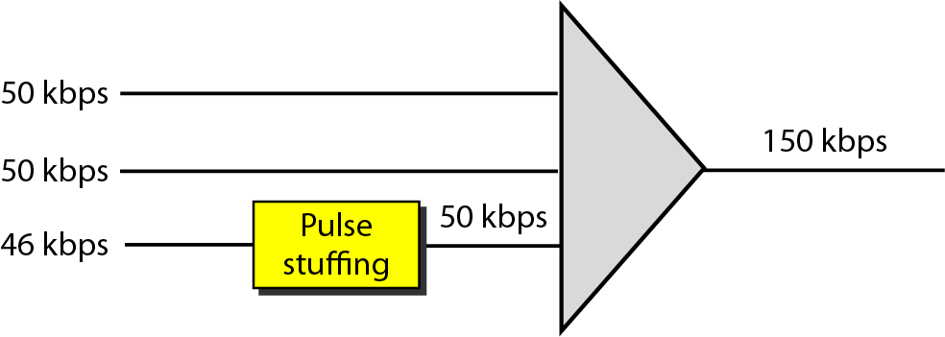
Pulse stuffing
Sometimes the bit rates of sources are not multiple integers of each other. Therefore, neither of the above two techniques can be applied. One solution is to make the highest input data rate the dominant data rate and then add dummy bits to the input lines with lower rates. This will increase their rates. This technique is called pulse stuffing, bit padding, or bit stuffing. The input with a data rate of 46 is pulse-stuffed to increase the rate to 50 kbps.
6.41
Notes:
*

Slide 42
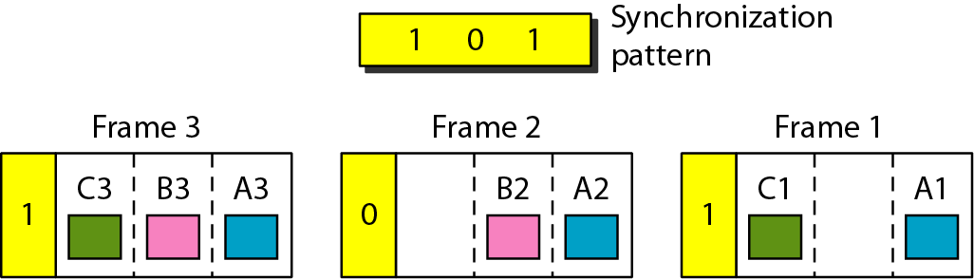
Frame Synchronization in Synchronous TDM
Synchronization between the multiplexer and demultiplexer is a major issue.
If the, multiplexer and the demultiplexer are not synchronized, a bit belonging to one channel may be received by the wrong channel.
For this reason, one or more synchronization bits are usually added to the beginning of each frame. These bits, called framing bits, follow a pattern, frame to frame, that allows the demultiplexer to synchronize with the incoming stream so that it can separate the time slots accurately. In most cases, this synchronization information consists of 1 bit per frame, alternating between 0 and 1.
6.42
Notes:
*

Slide 43
Statistical Time Division Multiplexing
In synchronous TDM, each input has a reserved slot in the output frame. This can be inefficient if some input lines have no data to send.
In statistical time-division multiplexing, slots are dynamically allocated to improve bandwidth efficiency.
Only when an input line has a slot's worth of data to send is it given a slot in the output frame.
The multiplexer checks each input line in round robin fashion. It allocates a slot for an input line if the line has data to send otherwise it skips the line and checks the next line.
6.43
Notes:
*

Slide 44
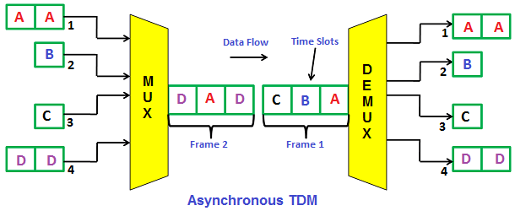
How Statistical Time Division Multiplexing actually works?
In Asynchronous time division multiplexing, the time slots are not fixed (I.e. time slots are flexible). The asynchronous TDM is also known as statistical time division multiplexing.
In synchronous TDM, the number of time slots is equal to the number of devices (transmitters). But in Asynchronous TDM, the number of time slots is not equal to the number of devices (transmitters). The time slots in asynchronous TDM are always less than the number of devices (transmitter). For example, if we have X devices and Y time slots. Y should always be less than X (I.e. Y < X).
6.44
Notes:
*

Slide 45
How Statistical Time Division Multiplexing actually works?
In asynchronous time division multiplexing, time slots are not fixed to a particular device; instead, they are allotted to any of the devices that have data to send.
In the above figure, it is shown that the number of devices are 4 and time slots are 3. The timeframe 1 (all slots) is completely filled with data from devices A, B, and C. The timeframe 1 has only 3 time-slots. So the data from device D is filled in the next timeframe (I.e. timeframe 2) in timeslot 1. The data from devices A and D will be filled in timeslots 2 and 3 in timeframe 2.
In asynchronous time division multiplexing, the multiplexer scans all the devices (transmitters) and accepts input only from the devices that have actual data to send and fills all the frames, and then sends it to the receiver.
If there is not enough data to fill all the slots in a frame, then the partially filled frames are transmitted. In most of the cases, all the time slots in frames are completely filled.
6.45
Notes:
*

Slide 46
Statistical Time Division Multiplexing
6.46
Notes:
*

Slide 47
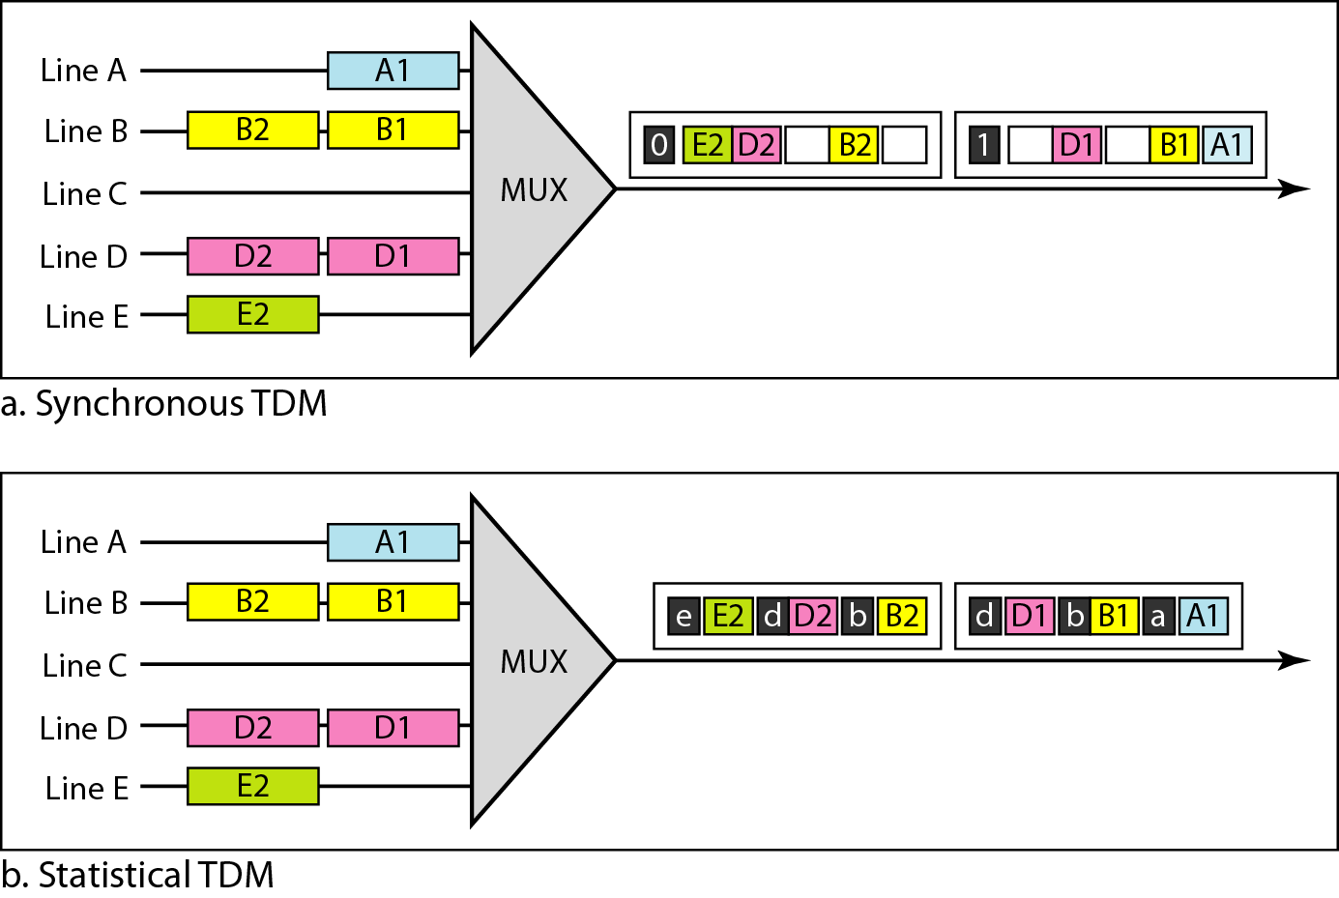
Synchronous vs Statistical TDM Slots Comparison
6.47
Notes:
*

Slide 48
Synchronous vs Statistical TDM Slots Comparison
Slot Size: Since a slot carries both data and an address in statistical TDM, the ratio of the data size to address size must be reasonable to make transmission efficient. For example, it would be inefficient to send 1 bit per slot as data when the address is 3 bits. This would mean an overhead of 300 percent. In statistical TDM, a block of data is usually many bytes while the address is just a few bytes.
No Synchronization Bit: There is another difference between synchronous and statistical TDM, but this time it is at the frame level. The frames in statistical TDM need not be synchronized, so we do not need synchronization bits.
Bandwidth: In statistical TDM, the capacity of the link is normally less than the sum of the capacities of each channel. The designers of statistical TDM define the capacity of the link based on the statistics of the load for each channel. If on average only x percent of the input slots are filled, the capacity of the link reflects this. Of course, during peak times, some slots need to wait.
6.48
Notes:
*

Slide 49
Advantages and Disadvantages of Time Division Multiplexing (TDM)
Advantages of Time Division Multiplexing (TDM)
Full bandwidth is utilized by a user at a particular time.
The time division multiplexing technique is more flexible than frequency division multiplexing.
In time division multiplexing, the problem of crosstalk is very less.
Disadvantages of Time Division Multiplexing (TDM)
In time division multiplexing, synchronization is required.
6.49
Notes:
*

Slide 50
Spread Spectrum
Spread spectrum combines signals from different sources to fit into a larger bandwidth.
How does spread spectrum is different from multiplexing?
Even though they are combining signals but the goals are quite different. In multiplexing, we are focused on efficiency that means how to maximize the utilization of available bandwidth. However, in spread spectrum our goal is to ensure privacy and antijamming property.
Spread spectrum is designed to be used in wireless applications (LANs and WANs).
In wireless applications, Stations must be able to share this medium without interception by an eavesdropper and without being subject to jamming from a malicious intruder.
To achieve these goals, spread spectrum techniques add redundancy; they spread the original spectrum needed for each station.
6.50
Notes:
*

Slide 51
Spread Spectrum
6.51
6.52
Notes:
*

Slide 52
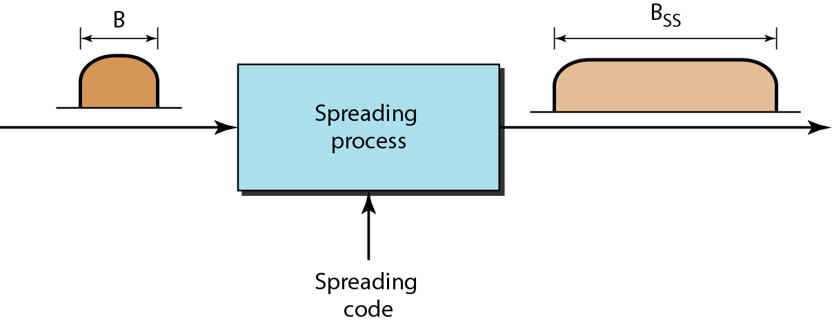
Spread Spectrum
Notes:
*

Slide 53
Frequency Hopping Spread Spectrum (FHSS)
6.53
Notes:
*

Slide 54
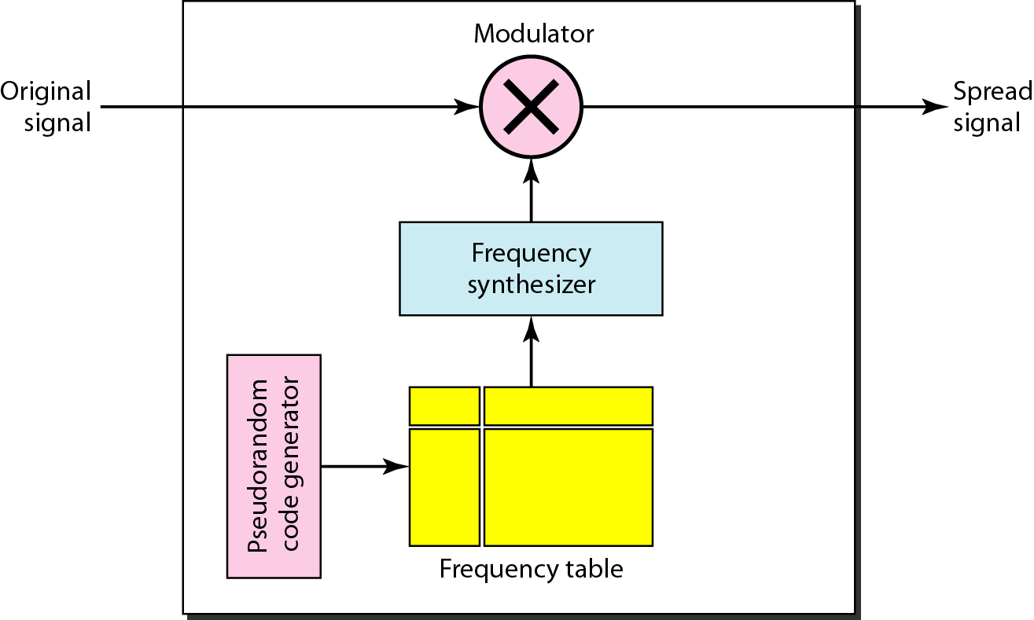
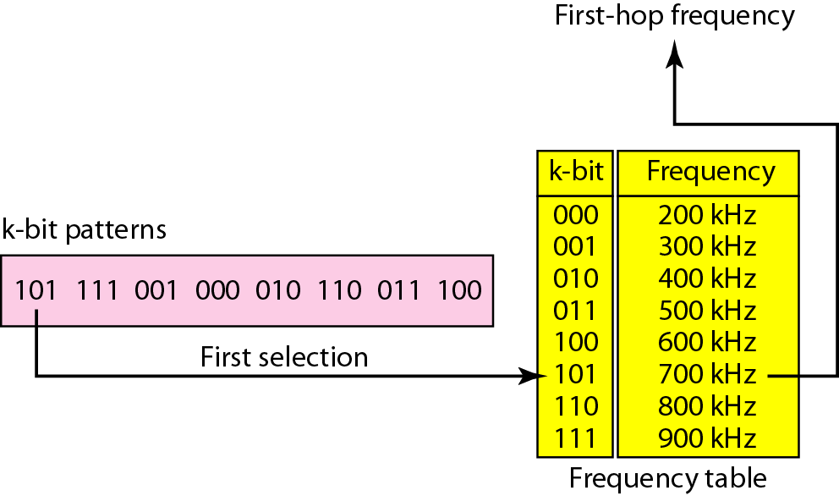
Frequency Hopping Spread Spectrum (FHSS)
6.54
Notes:
*

Slide 55
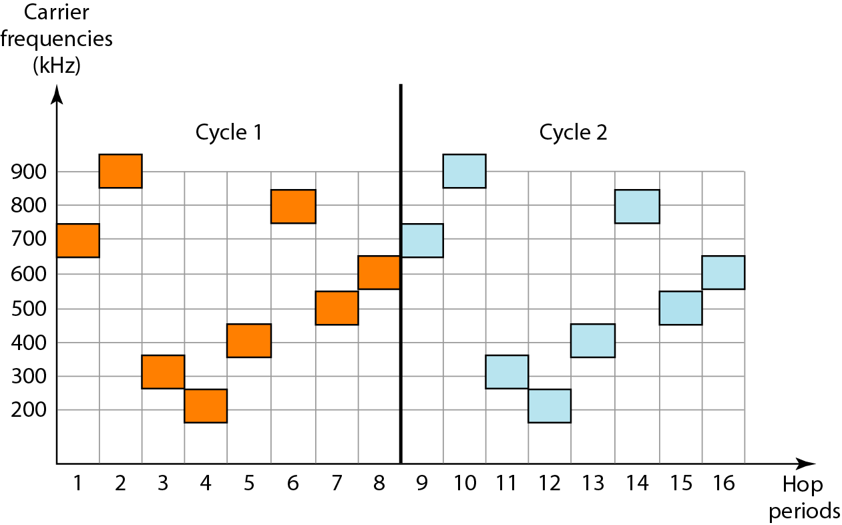
(FHSS Cycles)
The pattern is pseudorandom, hence it is repeated after in each cycle.
6.55
Notes:
*

Slide 56
How does FHSS accomplish the goals of spread spectrum?
If there are many k-bit patterns and the hopping period is short, a sender and receiver can have privacy.
If an intruder tries to intercept the transmitted signal, she can only access a small piece of data because she does not know the spreading sequence to quickly adapt herself to the next hop.
The scheme has also an antijamming effect. A malicious sender may be able to send noise to jam the signal for one hopping period (randomly), but not for the whole period.
6.56
Notes:
*

Slide 57
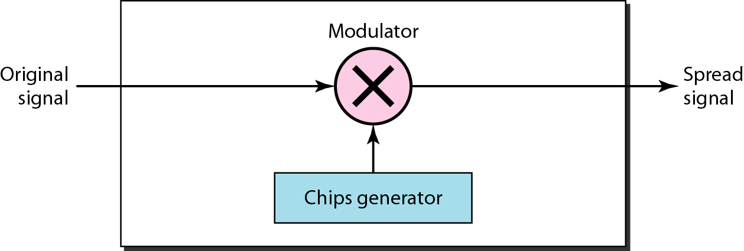
Direct Sequence Spread Spectrum
It also expands the bandwidth of the original signal, but the process is different.
In DSSS, we replace each data bit with n bits using a spreading code.
In other words, each bit is assigned a code of n bits called chips, where the chip rate is n times that of the data bit.
6.57
Notes:
*

Slide 58
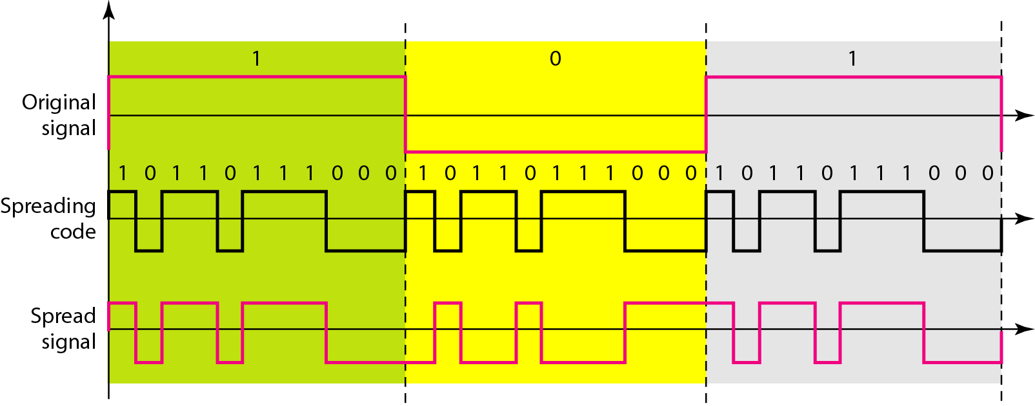
DSSS Example
Let us consider the sequence used in a wireless LAN, the famous Barker sequence where n is 11. We assume that the original signal and the chips in the chip generator use polar NRZ encoding.
The spreading code is 11 chips having the pattern 10110111000.
If the original signal rate is N, the rate of the spread signal is 11*N.
This means that the required bandwidth for the spread signal is 11 times larger than the bandwidth of the original signal.
6.58
Notes:
*

Slide 59
How does DSSS accomplish the goals of spread spectrum?
The spread signal can provide privacy if the intruder does not know the code.
It can also provide immunity against interference if each station uses a different code.
6.59
Notes:
*

